Slide 1

Artificial Intelligence
Deep Reinforcement Learning
Dr. Rajiv Misra, Professor
Dept. of Computer Science & Engg.
Indian Institute of Technology, Patna
rajivm@iitp.ac.in

Slide 2
Deep Q-Learning

Slide 3
Basic Concepts of Q Learning for Deep Q Networks
Q learning is a type of reinforcement learning algorithm that is denoted by Q(s,a) where
Q= Q learning function
s= state of the environment
a= action of the agent
This is called the action value function of the learning algorithm. The main purpose of Q learning is to find the optimal policy to maximize the expected cumulative reward.

Slide 4
Bellman Equation in Q learning
The core update rule for Q learning is the Bellman equation.
This updates the Q values iteratively on the basis of rewards received during the process.
Moreover, future values are also estimated through this equation.
The Bellman equation is given as:
Q(s,a)←(1−α)⋅Q(s,a)+α⋅[R(s,a)+γ⋅maxa′​Q(s′,a′)]
γ = discount factor of the function which is used to balance between immediate and future rewards.
R(s, a) = immediate reward of taking the action “a” within the state “s”.
α= The learning rate that controls the step size of the update. It is always between 0 and max[Q(s′,a′)] = The prediction of the maximum Q values over the next state s′ and action value a′

Slide 5
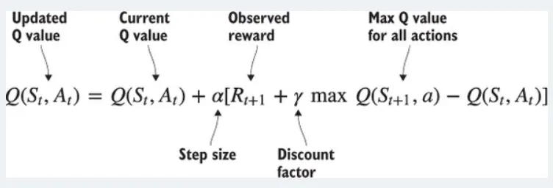
What is Q-Learning
The main idea of Q-learning is that your algorithm predicts the value of a state-action pair, and then you compare this prediction to the observed accumulated rewards at some later time and update the parameters of your algorithm, so that next time it will make better predictions. The Q-learning update rule is mentioned below:
The above formula tells us that, the updated Q value at time t is the sum of the current Q-value and the expected Q-value in the future provided we play optimally from the current state. The discount factor (from 0 to 0.99) tells us how important is the future reward for us to take the current action

Slide 6
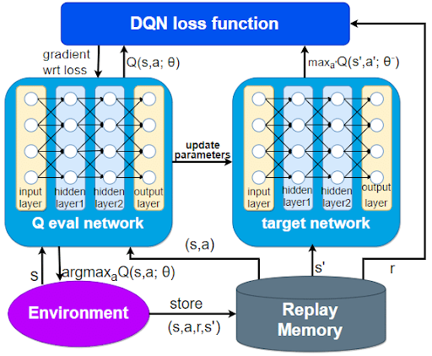
What is Deep Q Network (DQN)
The deep Q networks are the type of neural networks that provide different models such as the simulation of video games by using the Q learning we have discussed earlier.
These networks use reinforcement learning specifically for solving the problem through the mechanism in which the agent sequentially makes a decision and provides the maximum cumulative reward.
This is a perfect combination of learning with the deep neural network that makes it efficient enough to deal with the high dimensional input space.
This is considered the off-policy temporal difference method because it considers the future rewards and updates the value function of the present state-action pair. It is considered a successful neural network because it can solve complex reinforcement problems efficiently.

Slide 7
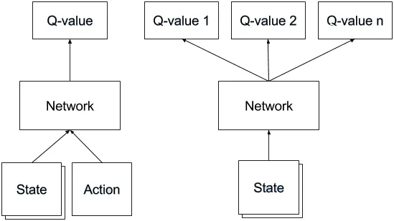
How a neural network Q function works
The network takes a state(s’) as the input and produces the Q-values for every action in the action space (no of actions depends on the game/environment).
The neural network job is to learn the parameters so assume that the training is done and we got the final network ready.
At the time of prediction, we use this trained network to predict the next best action to take in the environment.
Give an input state and the network gives the Q values for all actions then we take the max Q-value to take the corresponding action in the environment.
best_action = arg max(NN predicted Q-values )
Which means → for this state, this is the best_action to take in the env.

Slide 8
Training DQN
This is a regression problem, so we use any regression loss function to minimize the total error of the training data.
neural network loss function for predicting the Q values
l2_loss = (predicted — actual ) **2
assume the “predicted” gives the list of action values from the neural network where we take the maximum value(maximum reward).
Since we don’t know the “actual” as it’s a reinforcement learning ( not supervised so no labels) so we have to estimate the “actual” value
actual= R + γ max A` Q(S`, A`)
R → the current immediate reward
S` → Next state
max A` Q(S`, A`) → max( NN output list of Q-values)
γ → the discount factor γ → {0,1}

Slide 9
Training DQN
The reason for this is
if you take that particular action you will know the reward R and predict the next max reward with some discount.
assume the next max reward predicted by the model is completely wrong because the model just started training but we still have the R reward that is 100% right so slowly we adjust network parameters to predict the reasonable predictions.
In a sense it predicts it’s own actual value but since R is not biased ( when we step into the environment we observe the reward which is fully right ), the network is gonna update it’s gradients using backprop to converge.
Question arises:
Since we don’t have labels, we said actual= R + γ max A` Q(S`, A`) but how do we get the values for R and max A` Q(S`, A`) from the environment for a particular state?
Hint: Usually we get the reward R and Next state S` when we perform an action in the env only

Slide 10
Example of DQN training for Atari
now let’s take a problem to understand it’s implementation better.
In 2013 Deepmind developed the first deep learning model to successfully learn control policies directly from high-dimensional sensory input using reinforcement learning.
The model is a convolutional neural network, trained with a variant of Q-learning, whose input is raw pixels and whose output is a value function estimating future rewards.
They apply their method to seven Atari 2600 games from the Arcade Learning Environment, with no adjustment of the architecture or learning algorithm. they find that it outperforms all previous approaches on six of the games and surpasses a human expert on three of them. they published a paper.

Slide 11
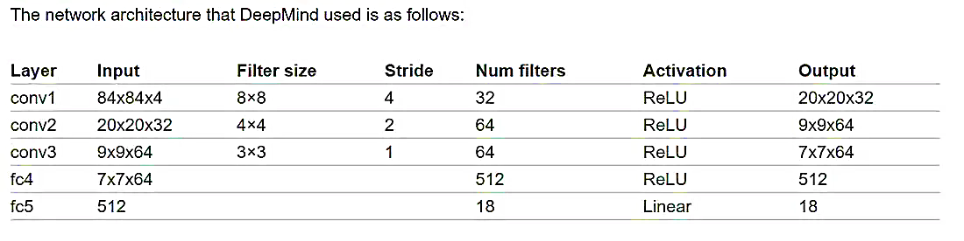
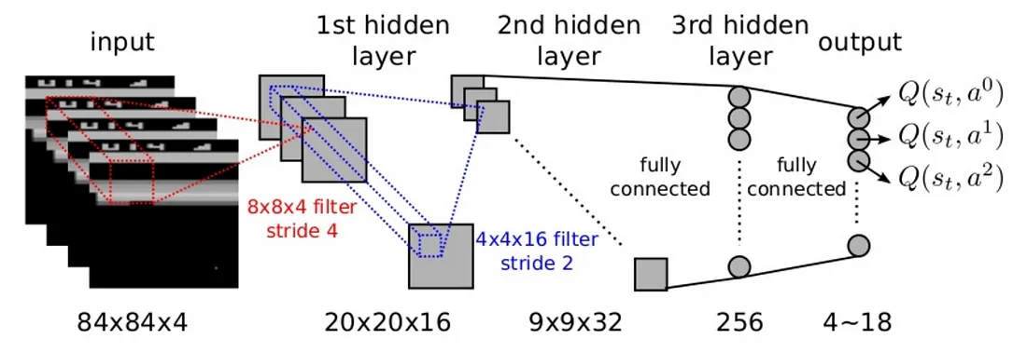

Slide 12
Example of DQN training for Atari
In simple terms
Take the image, turn it to a gray scale image and crop the necessary image part.
Apply some convolution filters and full connected layers with the output layers.
Give that image ( we call “state”) , calculate the qvalues , find the error and backpropagate.
Repeat this process as long as you want.
There are some problems in this process which led us to the Tricks I mentioned before.

Slide 13
Deep Q learning Trick
Skipping frames: in just one frame we can’t observe the motion of the picture ex: we cant tell in a picture whether the ball is moving up or down by just seeing one frame so we use this trick called Skipping frames which skips every 4 frames to take an action.
Experience replay : we store every experience(current state, current action, reward, next state) in the memory then we take a sample of batches from the memory. in this way, we can make training better and learning is reasonable.
Fixed Target network: since we don’t have labels , we make this equation to get the labels for the training and max A` Q(S`, A`) → is the NN output list of Q-values.
actual= R + γ max A` Q(S`, A`)
here we maintain another network we call the target network, and we assign the actual network weights to the target network for every N no of frames /iterations so that max A` Q(S`, A`) → is the target network output list of Q-values.
The reason for this is we update the actual network gradients for every frame/action so the network keeps on changing so it’s not feasible to use the same network for calculating the actual reward.

Slide 14
Deep Q learning Trick
Reward Clipping : every game / environment has it’s own reward system, some games it might have points like 100,200,300 and so on some games might have 1,2,3 and so on. so t o normalize the reward and penalty uniformly across all settings of environment, reward clipping is used.

Slide 15
Deep Q-Network (DQN) – Agorithm
Initialize components
  Create a replay memory M with capacity S.
  Initialize the Q-network with random weights θ.
  Initialize the target network with weights θ' = θ.
For each episode
  Reset the environment and obtain the initial state S.
For each timestep t
  Choose action A using ε-greedy policy:
    With probability ε → choose a random action.
    Otherwise → choose the action A = argmax Q(S, A; θ).
  Execute action A, receive:
    reward R
    next state S′
  Preprocess the next state S′.
  Store the transition (S, A, R, S′) in replay memory M.
Training step
  Sample a random minibatch of experiences (S, A, R, S′) from memory.
  Compute the target Y:
    If the episode terminated → Y = R
    Otherwise → Y = R + γ maxₐ Q′(S′, A; θ′)
    (using the target network)
  Update the Q-network by minimizing the loss:
  (Y − Q(S, A; θ))² with respect to θ.
Target network update
  Every C steps, copy weights from Q-network → target network:
  θ′ = θ
Move to next state
  Set S = S′ and continue.
DQN training algorithm
The training network Q and The target network Q` will get updated as we run more and more episodes.

Slide 16
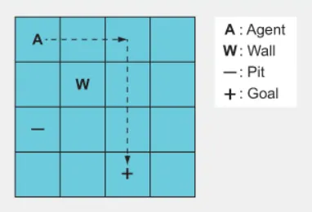
Example - Grid World
The Gridworld game depicted in figure shows the simple version of Gridworld. The agent (A) must navigate along the shortest path to the goal tile (+) and avoid falling into the pit (–)
The state for a GridWorld is a tensor representing the positions of all the objects on the grid.
Our goal is to train a neural network to play Gridworld from scratch. The agent will have access to what the board looks like. There are four possible actions namely up, down, left and right. Based on the action taken by the agent reward will be received. Reward of -1 is awarded for each move. Any action which leads to a fall in pit or into the wall will receive a reward of -10. Positive reward of +10 is awarded for successfully reaching the goal.

Slide 17
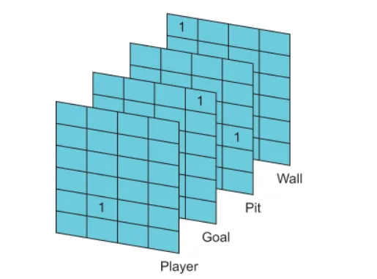
Grid World - State of the game
We start the game in some state that we’ll call S(t).
The state includes all the information about the game that we have. For our Gridworld example, the game state is represented as a 4 × 4 × 4 tensor. Its is the 4 slice of 4 X 4 grid as shown in fig below
Each grid slice represents the position of an individual object on the board and contains a single 1, with all other elements being 0s.
The position of the 1 indicates the position of that slice’s object

Slide 18
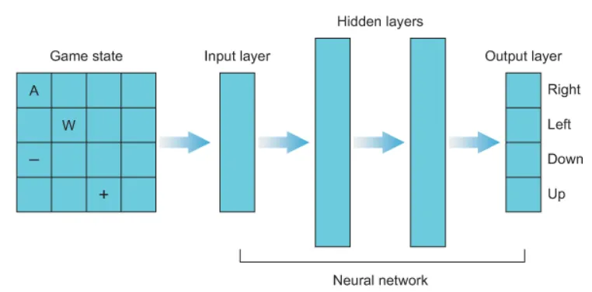
Grid World - State of the game
As our neural network agent will consume the state as the input vector we will have our input layer with 64 neurons

Slide 19
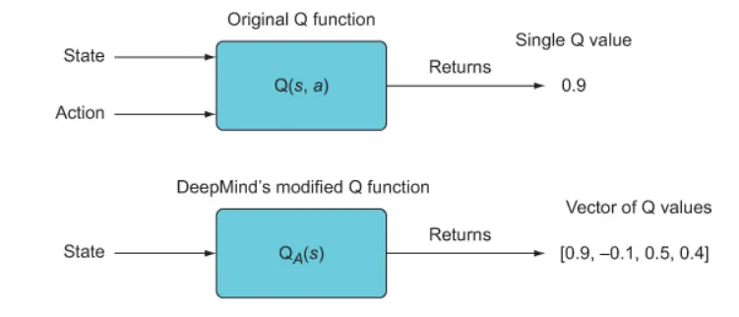
Grid World – Getting Expected Value of Prediction
In the vanilla Q-learning algorithm the state S(t) and the candid action is fed to the network and it predicts the expected value which is a single value.
In our case we have 4 possible actions and network should predict expected value 4 times with each action as an input. This will only increase the overhead and the processing time of the network.

Slide 20
Grid World – Getting Expected Value of Prediction
Hence DeepMind came with an idea to make network predict the probability distribution of all the actions . With this change the network has to make prediction only once. But this time the output vector will contain the probability distribution of all the possible actions. In our case the output of the network would be a vector of length 4 . The action corresponding to the max probability can be considered as the best at any particular state. The below image explains the change
The original Q function accepts a state-action pair and returns the value of that state-action pair — a single number. DeepMind used a modified vector-valued Q function that accepts a state and returns a vector of state-action values, one for each possible action given the input state. The vector-valued Q function is more efficient, since you only need to compute the function once for all the actions.

Slide 21
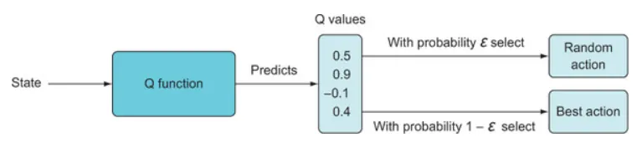
Grid World – Choosing the best action
Once we get the prediction of the probability distribution of each state from the network, we need to choose an action to take.
For this we can use the epsilon-greedy policy. With epsilon-greedy policy we choose a value of epsilon and with that probability we choose an random action (exploration) ignoring the predicted probability. With probability 1 — epsilon, we will select the action associated with the highest predicted Q value.

Slide 22
Grid World – Choosing the best action
Once the action is selected A(t), we will end up in a new state S(t+1) with observed reward R(t+1). The prediction of the expected value we got at S(t) is the predicted Q(S(t),A(t)).We now want to update our network with the actual reward it received for taking the action it recommended
In an epsilon-greedy action selection method, we set the epsilon parameter to some value, e.g., 0.1, and with that probability we will randomly select an action (completely ignoring the predicted Q values) or with probability 1 — epsilon = 0.9, we will select the action associated with the highest predicted Q value. An additional helpful technique is to start with a high epsilon value, such as 1, and then slowly decrement it over the training iterations.

Slide 23
Grid World – Update network
Now we run the network at s(t+1) and get the expected value which we call as Q(S(t+1),a) and figure out the action we need to take. To be clear, this is a single value that reflects the highest predicted Q value, given our new state and all possible actions.
We’ll perform one iteration of training using some loss function, such as mean-squared error, to minimize the difference between the predicted value from our network and the target prediction:

Slide 24
Problem - Catastrophic forgetting
The idea of catastrophic forgetting is that when two game states are very similar and yet lead to very different outcomes, the Q function will get “confused” and won’t be able to learn what to do.
We were able to train our model on a static environment where, every time the model saw objects, player and goal in the same position. But when agent was trained on more complicated initialization where environment was randomly initialized everytime a new episode is created, it failed to learn.

Slide 25
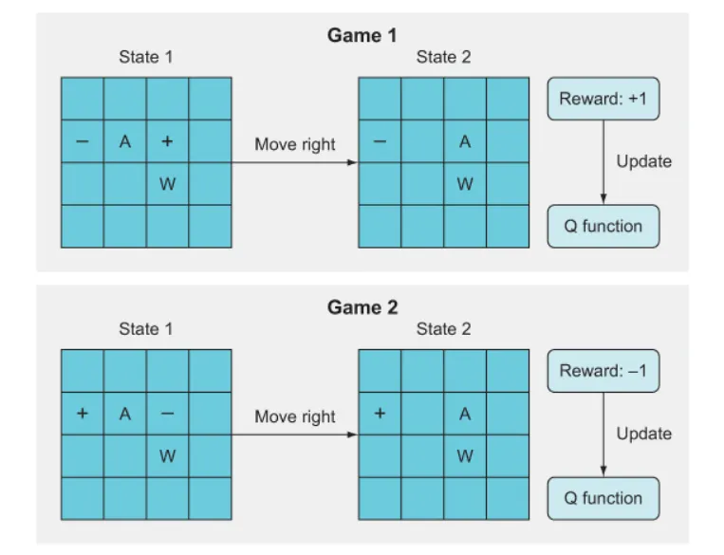
Problem - Catastrophic forgetting
In this example, the catastrophic forgetting happens because the Q function learns from game 1 that moving right leads to a +1 reward, but in game 2, which looks very similar, it gets a reward of –1 after moving right. As a result, the algorithm forgets what it previously learned about game 1, resulting in essentially no significant learning at all.

Slide 26
Problem - Catastrophic forgetting
The reason for Catastrophic forgetting is that we are updating the weights after every move of the game.
We generally don’t have this problem in the supervised learning realm, because we do randomized batch learning where we don’t update our weights until we’ve iterated through some random subset of training data and computed the sum or average gradient for the batch.
This averages over the targets and stabilizes the learning.

Slide 27
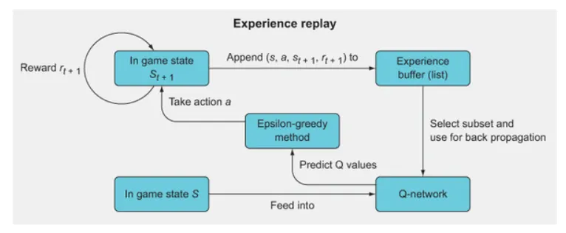
Solution - Experience replay
Experience replay gives us batch updating in an online learning schema.
The above figure shows the general overview of experience replay, a method for mitigating a major problem with online training algorithms: catastrophic forgetting. The idea is to employ mini-batching by storing past experiences and then using a random subset of these experiences to update the Q-network, rather than using just the single most recent experience.

Slide 28
Solution - Experience replay
The steps involved in experience replay are
In state s, take action a, and observe the new state s(t+1) and reward r(t+1).
Store this as a tuple (s, a, s(t+1), r(t+1)) in a list.
Continue to store each experience in this list until you have filled the list to a specific length (this is up to you to define).
Once the experience replay memory is filled, randomly select a subset (again, you need to define the subset size).
Iterate through this subset and calculate value updates for each subset; store these in a target array (such as Y) and store the state, s, of each memory in X.
Use X and Y as a mini-batch for batch training. For subsequent epochs where the array is full, just overwrite old values in your experience replay memory array.

Slide 29
Policy Gradients

Slide 30
Policy Gradients
In Q learning, for a given state we calculate the Q value for every action in the action space and we pick the max value and it’s corresponding action ( so choosing actions depends on the Q value )
This method is called a Value-based method and there is another method called a Policy based method.
Question: why use policy based methods ??
There are couple of reasons:
The ultimate goal of RL is to find an optimal policy ( it can be done using the value function, so far we have seen it, and it can also be done without the value function)
In the value learning above approach, we calculate the Q values for all possible actions in the action space (we only got less actions so we could follow the above approach but in real world , the number of actions can be a lot or can’t be imaginable)

Slide 31
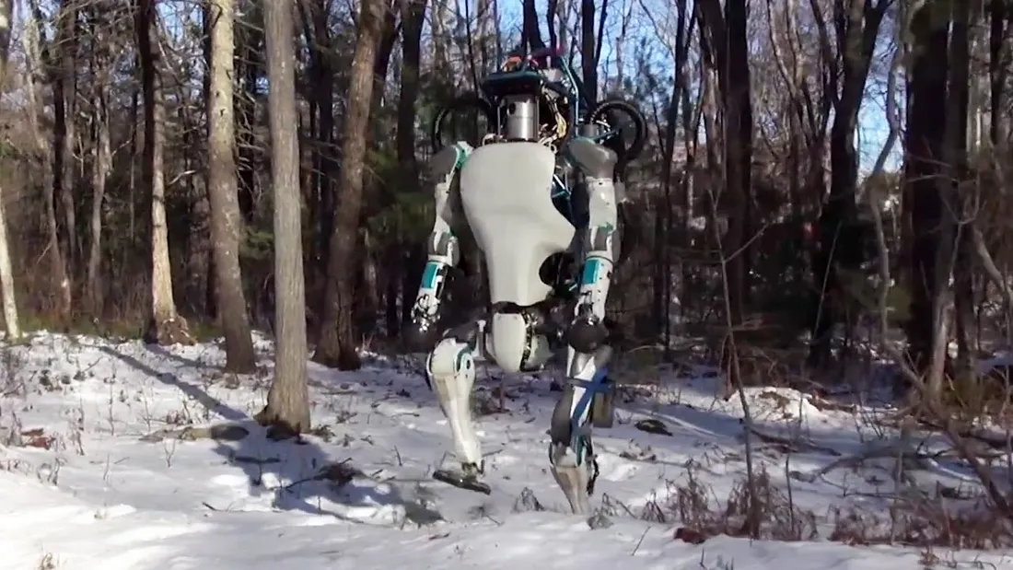
Policy Gradients
Ex: Robot walking - This one is continuous and high dimensional action space.
So, we need to learn the optimal policy for higher action space which policy-based methods do exactly.
In policy-based methods, we directly learn our policy function π without worrying about a value function.
Which means we can choose actions without calculate the Q(S,A) values.
Deep-Q-learning is a value based method while Policy Gradient is a policy based method.
There are couple of advantages using the policy gradient methods:
It can learn the stochastic policy which is useful for handling the exploration/exploitation trade off.
Often the policy is simpler to learn than value function.

Slide 32
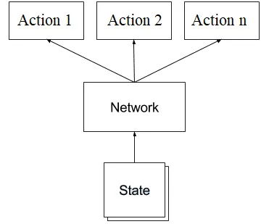
How does policy gradient work?
as we know in policy gradients , we directly learn the policy function π which gives the probability distribution of actions.
π (A|S) → Probability of taking action A given state S.
we use function approximation ( ex: neural net) to find this policy function π
π (A|S;θ) → Probability of taking action A given state S with parameters θ.
The diagram is similar to DQN but this is a classification problem while DQN is a regression problem.
The network takes state as an input and produces the probability distribution of actions.
The process in simple terms → we give a state ,get the action probs, take the action given by pi in the env, observe next state & reward, repeat it till the end of the game and if end, update the parameters in the network based on the rewards we collected (backprop).

Slide 33
cost function in policy gradients
DQN is a regression problem so we have used L2 loss function as cost function and we minimize that loss during the training. but Policy Gradient is a classification problem so we use log likelihood or cross entropy.
since we don’t have labels ( for a given state this is the best action ) , we have to create “fake labels” to continue with training.
we just sample the actions that need to be performed in the environment, we just label those actions as fake labels we happened to sample for given states as follows:
Σ logp(yt | xt ; ϴ)
xt and yt are training examples and labels respectively.
Our goal now is → to increase the log probability for actions at the last layer.
Policy gradients are similar to supervised learning except a change in the loss function.
The fake labels can’t be real so we focus on the outcome ( in case of a game we focus on the final reward) to improve the fake labels to get close to the actual labels.

Slide 34
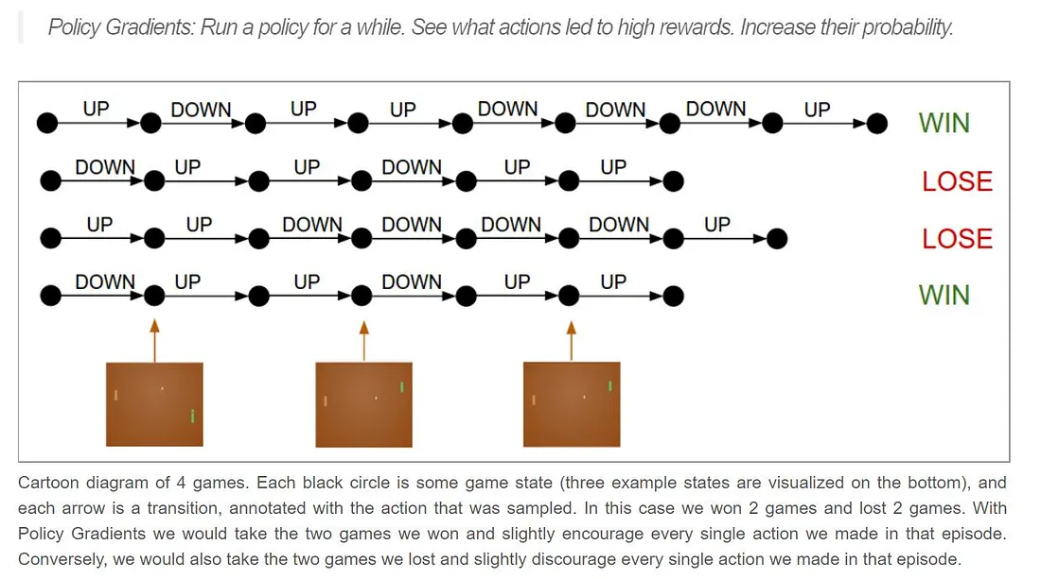
Example - policy gradients
let’s take an example of the pong game

Slide 35
Example - policy gradients
Process
1. we take a policy and roll out an episode ( a game)
There are n no of frames per second and each frame is considered as a state
2 . for every state we sample an action(fake label), perform it in the environment and observe the reward & next state
3 . if end, if the reward is positive( it tells us the actions we took in the episode are good) so we push up the probabilities for all the actions taken in that episode , if the reward is negative( the actions we took in that episode are kinda bad) so we push down the probabilities for all the actions taken in that episode.
so our final loss function should look like this:
Σlogp(yt | xt ; ϴ) * At
Where At = Rt ( reward at time step t)
our goal now is → to increase the log probability for actions that worked and decrease it for those that didn’t with an advantage A .

Slide 36
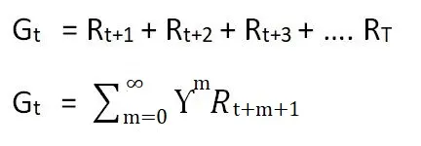
Example - policy gradients
We can use the reward as the advantage , cause if we get the positive reward we push up the probabilities, if we get the negative reward we push down the probabilities.
but there is a problem here - lets say we lost the game and we get the negative reward so we are about to push down the probabilities for all actions that we took in that episode, some actions may be super good in that episode but at the end we got negative reward so we blame that action also which is bad.
blaming all the actions equally is not a good idea, so we slightly modify the actual reward.
at each time step/state we get the reward so we use discounted reward with a little change in notation .
Gt is the total reward, γ being the discount factor.

Slide 37
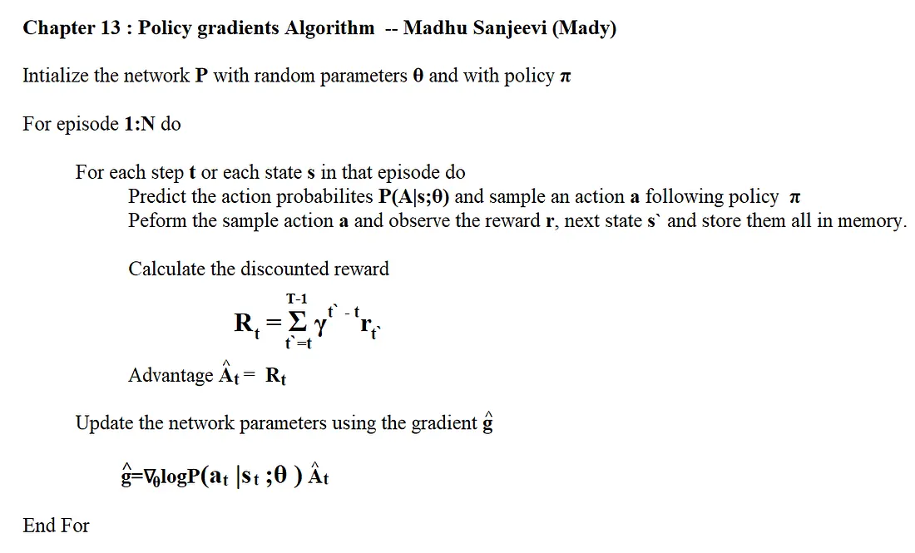
Training - policy gradients
so we got our labels, loss function, discounted rewards and gradients
Setup the network architecture ( based on the game/environment).
Run a policy π (A|S;θ) to predict the actions (it includes net output and action picking choice).
Take those actions ,observe the reward and next state , calculate the loss and gradient and store them all in memory till the end of the episode.
At the end, calculated the discounted reward and calculate the gradient wrt θ and update the network weights using any optimization algorithm.
Repeat 2–4 as long as you want.

Slide 38
Summary
→ Deep reinforcement learning is like adding a neural network to an environment to accomplish the goals in that env.
→ DQN is like taking some random actions and learning from them through the Q value function and it’s a regression problem (L2 loss is used) where two networks are used for training.
→ PG is like learning the optimal behaviour directly from the experiences (no value function) and it’s a classification problem( maximum log likelihood is used with a some minor change ).

Slide 39
Thank You
Dr. Rajiv Misra, Professor
Dept. of Computer Science & Engg.
Indian Institute of Technology, Patna
rajivm@iitp.ac.in

